Slide 1
Workplace Diversity

Slide 2
Workplace Diversity
Definition: Workplace diversity is a people issue, focused on the differences and similarities that people bring to an organization.
It is usually defined broadly to include dimensions beyond those specified legally in equal opportunity and affirmative action non-discrimination statues.
Diversity is often interpreted to include dimensions which influence the identities and perspectives that people bring, such as profession, education, parental status and geographic location.

Slide 3
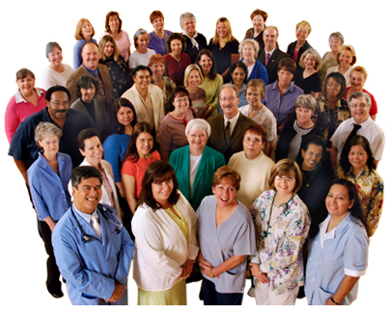
Workplace Diversity
As a concept, diversity is considered inclusive to everyone. In many ways, diversity initiatives complement non-discrimination compliance programs by creating the workplace environment and organizational culture for making differences work.
Diversity is about learning from others who are not the same, about dignity and respect for all, and about creating workplace environments and practices that encourage learning from others and capture the advantage of diverse perspectives.

