Slide 1

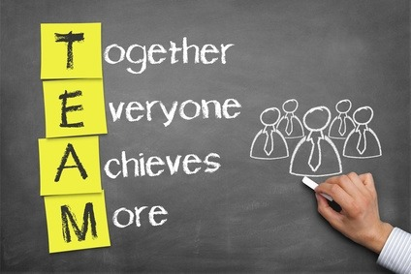
Building Team Synergy

Slide 2
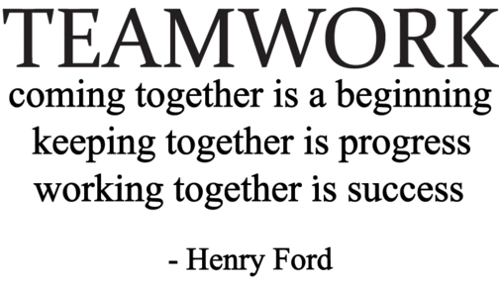
Objectives
To discuss/review how our thoughts and attitudes influence our colleagues
Discover the importance of the role we each have in building teamwork
To have fun!

Slide 3
Synergy
What is it?
  People working together in a spirit of unity and harmony – valuing and supporting each other
  The “whole” is greater than the “sum” of its parts
  2 + 2 is greater than 4
When people work together in a spirit of unity and harmony, a stronger power develops.

Slide 4
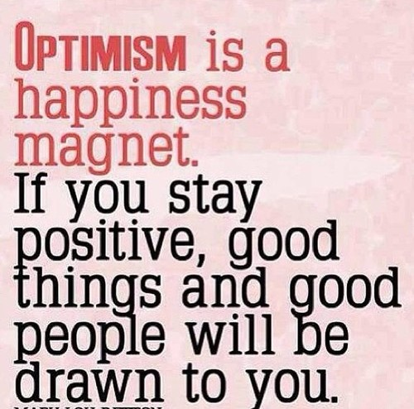


What Helps to Create a Harmonious Work Environment?
Remember: Our thoughts, whether positive
or negative, impact the people around us

Slide 5

Chinese Symbol for People
The Chinese symbol for people reinforces the concept of synergy. Each stroke represents a person.
You’ll notice that each strengthens the other. If either is taken away, both will fall.
In these changing times, we need the strengths of everyone working together!

Slide 6

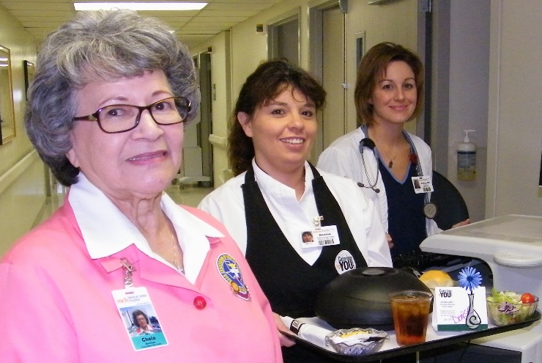
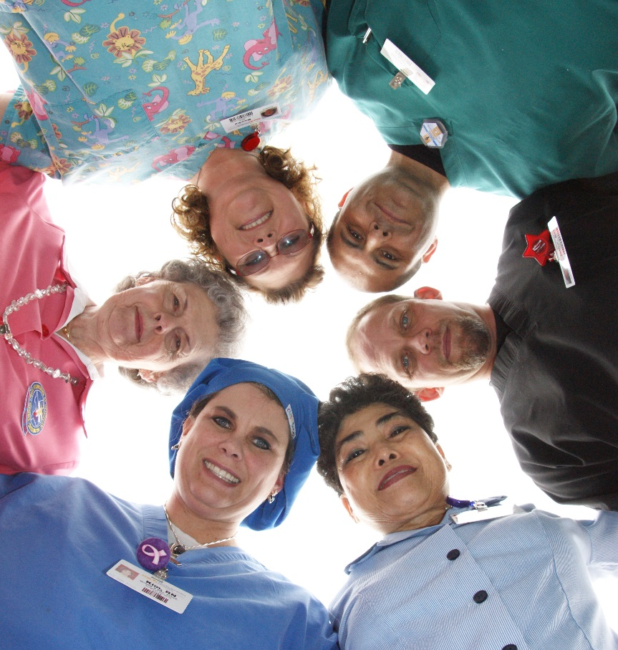

There are
NO INSIGNIFICANT POSITIONS at Medical Center Health System!

Slide 7
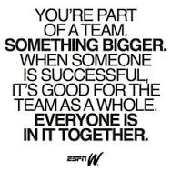
Application Ideas
Stay focused on your common team goal of creating value for patients.
Listen to your co-workers without biases – seek to understand them and what they’re saying.
Look for strengths in each co-worker and point them out (I-Care Champion Cards).
Look for strengths in yourself and point them out.
Be thankful each day for the opportunities and livelihood your job provides you.

Slide 8
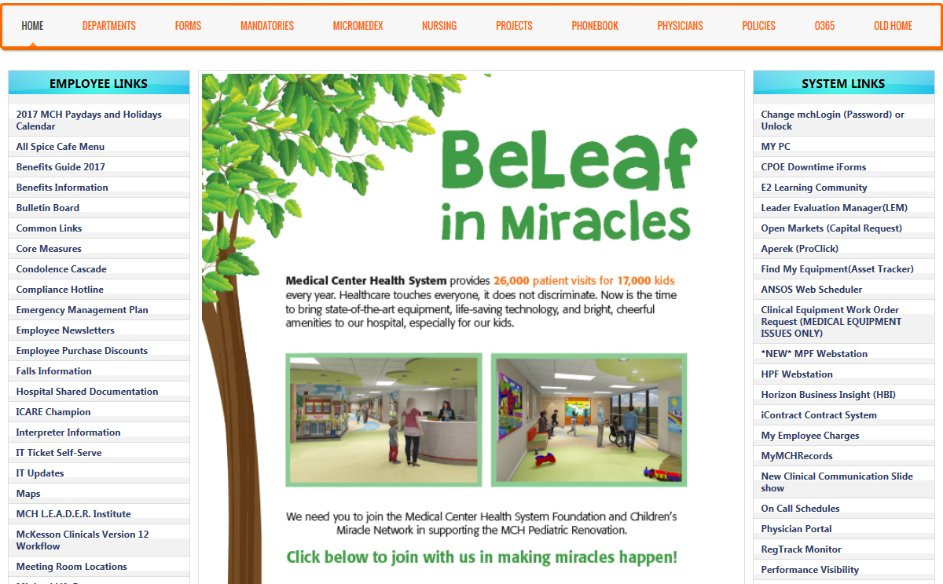
Reward & Recognition – I CARE Champion
Link found on the MCHS Intranet Home Page

Slide 9
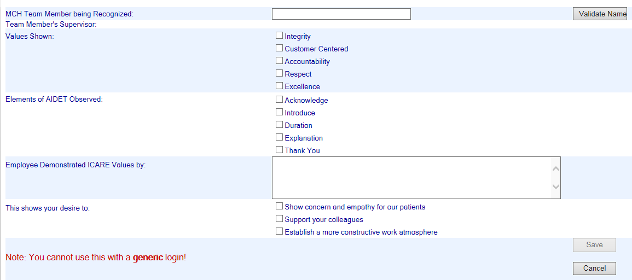
Reward & Recognition – I CARE Champion
Aligned with MCHS
I CARE Values
Aligned with AIDET Fundamentals
Specific action observed/experienced by team member being recognized.

Slide 10

It Takes TEAMWORK…
Did your nurse and doctors “always” communicate well with you?
Did you always receive help as soon as you wanted it?
Did the staff “always” explain your medications and their side effects?
Were the patient rooms and bathrooms “always” kept clean?

Slide 11
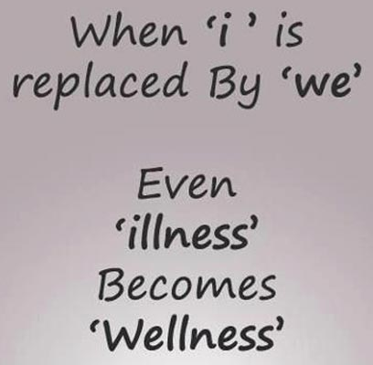
The Challenge:
To personally commit to supporting strong teamwork in your departments.

Slide 12
The Commitment
As your co-worker and with our shared organizational goal of excellent patient care, I commit to the following:
I will accept responsibility for healthy interpersonal relationships.
I will talk to you promptly if I am having a problem with you.
I will establish and maintain a relationship of trust with you.
I will not engage in the 3 “B’s.”
I will practice the 3 “C’s” – Caring, Commitment, Collaboration
I will not complain about another team member.
I will accept you as you are.

Slide 13
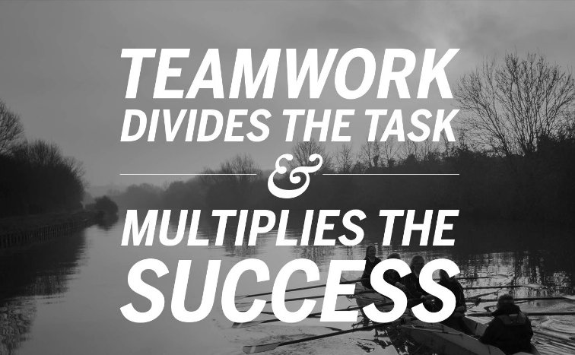
The Commitment (cont.)
I will be committed to finding solutions to problems.
I will affirm your contribution to the quality of our work.
I will remember that neither of us is perfect, and that human errors are opportunities, not for shame or guilt, but for forgiveness and growth.

Slide 14



