Slide 1
Security
Security
Brad Timmons
Chief of Police
DirectorSafety/Emergency Management

Slide 2
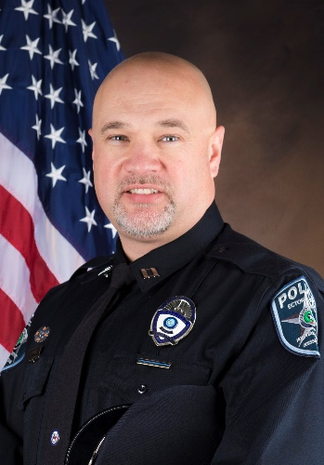
Brad Timmons – Chief of Police,
Director of Safety and Emergency Preparedness
Kelly Cecil – ECHD Police Captain
Supervisor over PBX/Switchboard

Slide 3
Louie Adame– ECHD Police Sergeant
Daniel Valenzuela– ECHD Police Sergeant

Slide 4
Calls for service
BADGE OFFICE
Across from Cafeteria – 1ST FLOOR
EXTENSION 1121
IDbadgegroup@echd.org
CUSTOMER SERVICE OFFICE
Located in the Hetzler Building
EXTENSION 2600
Any call for Engineering
ECHD POLICE
Dispatch in Police Admin Office (Secured)
EXTENSION 4040
Any Police/Security calls
PBX
Next to Auxiliary Desk at front entrance (Secured)
EXTENSION 0
EXT 2000 for all Medical or Police Emergencies

Slide 5
Police/SECURITY/SAFETY INCIDENT REPORTS
INCIDENTS
PATIENT VALUABLES, CRIMINAL OFFENSE, ETC.
EXTENSION 4040 FOR DISPATCH
EMERGENCY EXTENSION 2000
FOLLOW UP
HUMAN RESOURCES
ADMINISTRATION
PERFORMANCE IMPROVEMENT (Risk Mgt)

Slide 6
IDENTIFICATION BADGES
POLICY
MUST BE WORN AT ALL TIMES AT WORK.
MUST BE WORN ABOVE THE WAIST WITH NAME A PICTURE VISIBLE
REPORT STOLEN BAGES TO ext 1121 or HUMAN RESOURCES IMMEDIATELY
DO NOT ALTER YOUR BADGE

Slide 7
WORKPLACE VIOLENCE
Any act that threatens the safety, health, life or well being of an employee, patient or visitor
Results in damage to hospital, employee, patient or visitor property

Slide 8
WORKPLACE VIOLENCE
Prohibited acts include, but are not limited to:
Threats, intimidation, coercing, harassment or assault
Sexual harassment
Carrying a firearm
Allowing unauthorized access
Using, duplicating, or possessing keys without authorization
Theft
Vandalism

Slide 9
WORKPLACE VIOLENCE
Any employee who has been threatened, is a victim of a violent act, witnesses or learns of threats or violent acts, should report such activity to ECHD Police or Human Resources immediately.
May use Compliance boxes or Hotline at 1-800-805-1642. All calls may remain anonymous and confidential.
In an emergency, call 2000.

Slide 10
Workplace safety begins with realizing that “it CAN happen here” PREPARE NOW
The 9/11 commission concluded that our "most important failure was one of imagination." We simply couldn't imagine something of that magnitude actually happening, and thus didn't take the necessary preventive steps.
Survivors of workplace rampages almost always say afterward that they couldn't have imagined that an odd coworker could be lethal. People tend to see and hear what they want to see and hear.

Slide 11
Active shooter
An “active shooter” is considered to be a suspect or assailant whose activity is immediately causing serious injury or death and has not been contained.
TAKE IMMEDIATE ACTION
Survival Mindset
AVOID/DENY/DEFEND

Slide 12
Key Numbers
4040 - Police/Security Non-Emergency
2000 – Medical/Police Emergency
2600 – Engineering/Facility
1385 – I.T./ Telecom or BioMed/ Clinical Engineering
4000 or 0 – Operator/PBX
1121 – Badge issues or Access
1110 – TriMedx/Medical Equipment

