Slide 1
Medical Center Health System Risk Management

Slide 2
WHAT IS RISK MANAGEMENT?
Identification of risks
Assessment of risks
Prioritization of risks

Slide 3
COMMON SOURCES OF RISK
Communication Failures
IV therapy errors or injuries
Surgical Site Infections
Care/Service Coordination
Missing Belongings
Patient Misidentification
Consent
Chemical or Radiation exposure
Adverse Drug Reactions
AMA
Falls

Slide 4
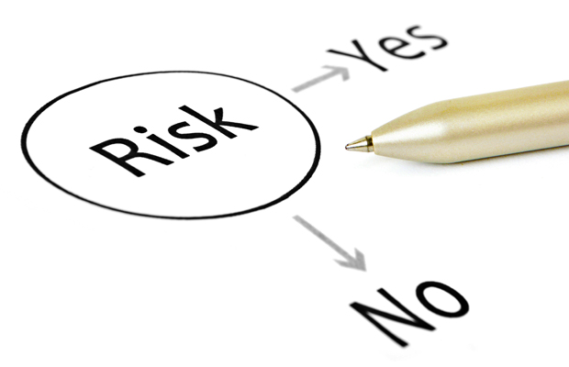
RISK MANAGEMENT
Everybody helps manage Risk!
Proactive RM to prevent or mitigate loss
Reactive RM damage control after an event has occurred.

Slide 5
Risk Management Reporting
LEARN – IMPROVE - PREVENT

Slide 6
Learn
Improve
Prevent
To learn what we can do better through trending and analysis of information reported.
We can’t fix what we don’t know.
To protect yourself and the organization from loss.
What we don’t know CAN hurt us.
WHY SHOULD I REPORT?

Slide 7
What Should I Report?

Slide 8
What Should I Report? Any happening not consistent with routine patient care Any event not consistent with normal operations Any event that causes patient harm, or has the potential to cause harm A “near miss”: an event if it did occur had the potential to cause harm Knowing about adverse events and potential adverse events enables the hospital to analyze the events and put processes in place to prevent similar events from happening in the future.

Slide 9
Examples of reportable events
Falls
Diagnosis or treatment errors
Medication errors, adverse drug events
Blood transfusion errors
Patients leaving against medical advice
Wrong site, wrong patient procedures
Unexpected deaths
Surgical site infections
Maternal/childbirth events
Any unexpected event that adversely affects a patient
Unexpected deaths
Unplanned surgeries

Slide 10
How do I report?
MCH uses an on-line tool that we call ORTS—the Occurrence Reporting and Trending System
This is an on-line reporting tool for selecting the type of event, and guides you through the event identification process
On the MCH home screen, click on ORTS-MORTS and you will be taken to a screen with multiple icons, click on the icon which is the most appropriate, and enter the information about your report.

Slide 11
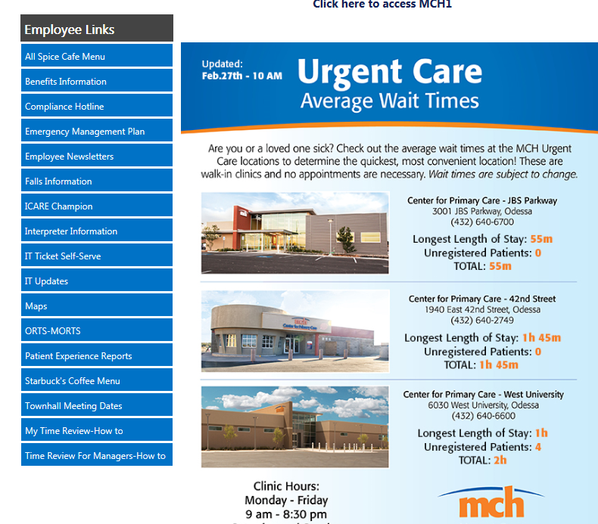

Slide 12
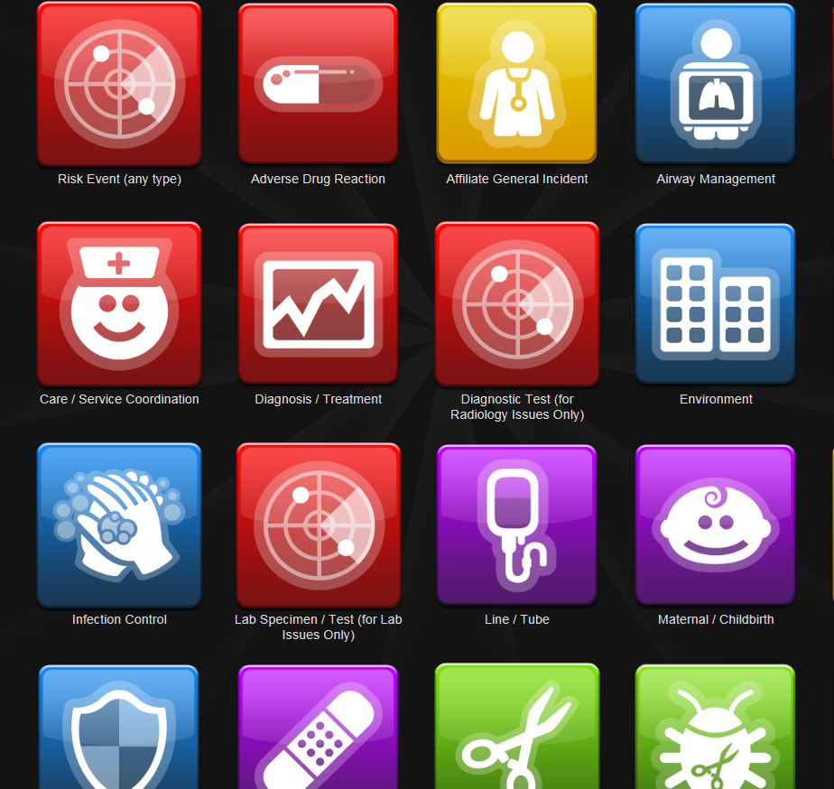

Slide 13
Understanding the ORTS severity classification
Categories A through D No harm to the patient
Categories E through I Temporary harm up to and including patient death as a result of the event

Slide 14
Severity Classification Examples
A medication order was entered on the wrong patient. It was quickly identified and the order was re-entered on the correct patient Category A
A patient was walking with assistance, he became weak and the physical therapist helped him to the floor. He was not injured Category C
A patient was walking in the hall with an IV pole. She tripped over the pole, fell, hitting her head. She required stitches for the laceration. Category E
A patient received contaminated TPN. The patient developed septicemia which was antibiotic resistant. The patient was transferred to a tertiary care facility where he spent 6 weeks in ICU. Category H
A patient died after receiving a heart and lung transplant from an incompatible donor. Category I

Slide 15
ORTS Tips/Reminders
Act quickly – critical information can be forgotten.
Avoid hearsay and assumptions – Document only what YOU see and/or heard personally. No “I thinks.”
Do not document that an ORTS report was submitted.
Do not make a copy of an ORTS report.
An ORTS report:
Does NOT become part of the patient's medical record
Does NOT include excuses for behavior or actions
Does NOT point fingers at other people or departments

Slide 16
NON PUNITIVE REPORTING MCH-4046
Learn
Improve
Prevent
To encourage open and honest reporting of errors, incidents and near misses to patients, visitors and staff.
To limit disciplinary action to those incidents that involve willful or malicious misconduct or those in which the employee did not report or follow remediation recommendations.
To facilitate education and problem resolution through disclosure of process failure and/or human error.

Slide 17
NON PUNITIVE REPORTING MCH-4046
THREE EXCEPTIONS
An event involving a workforce member who knowingly or intentionally acts with intent to harm or deceive.
An event involving a workforce member who is chemically impaired and/or engaged in criminal activity.
An event involving a workforce member who fails to respond to educational efforts and/or fails to participate in the education or other preventive plan.

Slide 18
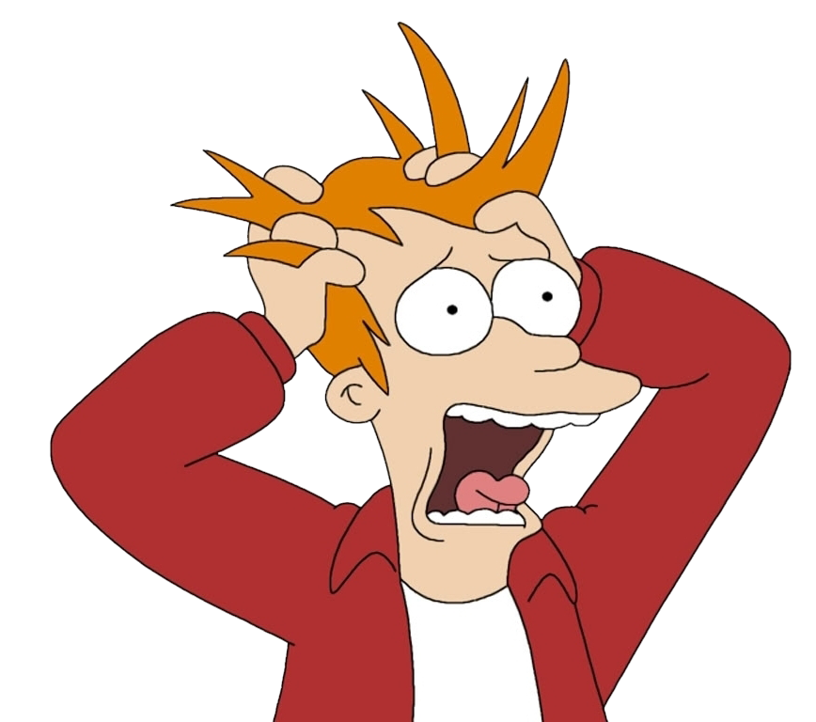
THE “L” WORD!
If a patient or patient’s representative threatens to get a
LAWYER
DO NOT PANIC!
Do Not engage in a conversation regarding their statement or the appropriateness of their concerns
Contact Risk Management
Continue to provide care

