Slide 1

Proper Body Mechanics

Slide 2
Body Mechanics
The use of one’s body to produce motion that is safe, energy conserving, and anatomically and physiologically efficient and that leads to the maintenance of a person's body balance and control

Slide 3
Benefits of Proper Body Mechanics
Conserve energy
Reduce stress and strain to muscles, joints, ligaments, and soft tissues
Promote effective, efficient respiratory, and cardiopulmonary function
Promote and maintain proper body control and balance
Promote effective, efficient, and SAFE movements

Slide 4
Causes of Back Injuries
Increase force/stress
Repetitive motion/twisting
Forward bending
Poor or improper lifting techniques
Poor posture
Poor job design
Poor physical fitness

Slide 5
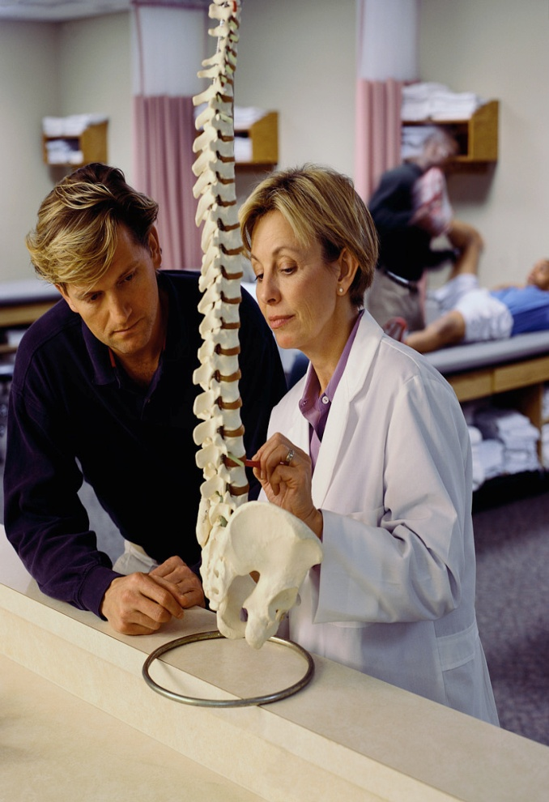
Causes of Back Injuries
Overweight
Smoking
Poor nutrition
Stress

Slide 6
Mechanics: Poor Posture
One of the main reason that injuries occur
Means that the spine’s normal curves are exaggerated or decreased creating stresses and strains in the tissues
The result is pain and dysfunction and can lead to serious injury

Slide 7
Mechanics: Forward Bending
Forward bending can over stretch the low back muscles to the point where they can lose strength to protect the spine from injury
The ligaments are also weakened
Can increase stress on the discs
Range of the bend and time spent in the position can determine amount of damage

Slide 8
Mechanics: Twisting
Repetitive twisting can do damage to the spine
It over stretches ligaments and muscles causing weakness
Can damage discs especially combined with bending

Slide 9
Mechanics: Poor Job Design/Ergonomics
Injury can occur when:
  Moving a load too heavy
  Moving a load too often
  Moving a load too far
  Twisting with a load
  Work too far too reach
  Cold temperatures
  Vibration
  Improper chair/equipment

Slide 10
Mechanics: Poor Work Habits
Poor Positions
Poor Movement
Improper lifting habits
Make the job more difficult
Repetitive twisting and bending

Slide 11
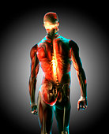
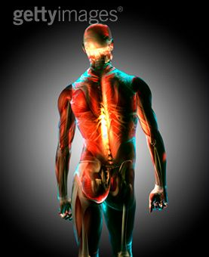
Mechanics: Poor Physical Fitness
Decreased oxygen delivery to muscles can cause muscles to wear down and lead to weakness

Slide 12
Mechanics: Overweight & Smoking
Creates extra work for the spine
Leads to excess fatigue and wear/tear in the body
Nicotine damages connective tissue decreasing circulation and oxygen in the blood which affects muscle strength

Slide 13
Mechanics: Nutrition & Stress
Muscles need protein to repair worn musculoskeletal tissue
Bones need minerals for strength
Stress stiffens and weakens back muscles and increases pain sensitivity

Slide 14
Body Mechanics: Quick Tips
Think about what you are doing
Know your work environment
Know the tools available
Know how to use the tools

Slide 15
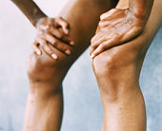
Quick Tips…….
Bend knees
Use legs
No twisting
Avoid long distances
Keep objects close to you

Slide 16
Proper Lifting Techniques
Stand with feet apart one foot slightly ahead of the other
Wide stance helps balance during lifting
Squat down keeping back straight, keep chin tucked, and lift smoothly
Keep objects close to you
Bend your knees and hips using legs to lift

Slide 17
Proper Lifting Techniques
Maintain lumbar curve
Do not twist or bend sideways
Face the object you are picking up
If changing direction, do not twist, pivot with your feet
If you reach over shoulder level, raise onto a low step to get closer to the object

Slide 18
Proper Lifting Techniques
Push rather than pull
Pushing is much easier for your back
Stabilize hands on the object, keep back in extended position, and do all the pushing and moving with your legs
Take your time! Hurrying causes muscles to contract inappropriately and increases chance of injury

Slide 19
Proper Lifting Techniques
Change stressful positions often
If you are sitting too long: Stand
If you are standing for too long: stop and squat
Carrying an object: hold the load close to the body

Slide 20
Prevention
Keep muscles and joints flexible
Exercise to decrease weight
Stay in shape
Increase muscle strength
Prepare safety is a lifestyle
Prepare for your job
Back safety is a lifestyle
Get plenty of rest/sleep
Interrupt stressful positions
Maintain good sitting posture
Maintain good standing posture
Perform back extensions
Wear comfortable clothes to allow movement
Healthy balanced diet

