Slide 1






Patient rights
Hospital Accreditation
A quick reference

Slide 2
Patients Rights
How do our patients know their rights…

Slide 3


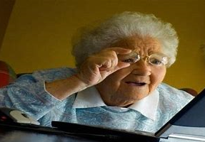
Patients and/or families know….
The internet gives the patients and family access to a lot of information !!!
  Sometimes they get unrealistic expectations or have read someone’s blog that was sensationally dramatic.
It can provide them with real information. ☺
Does this make them wrong???
No.

Slide 4


Patient Rights brochure from MCH what it covers…..

Slide 5
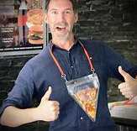

Your badge says ‘How can I help you’
Your opportunity to make a difference starts the moment they see you !!!
Your wear a MCH badge, and patients or families
know you can help.
You don’t even have to know the answer –
just be willing to help guide them to the next step
Helping a patient or family with answers… does qualify
as patient rights.
Which person would you want to ask for assistance????
The smiling guy…. Right???

