Slide 1
Organ donation overview
Essential Information for Healthcare Professionals

Slide 2
Who services Medical center hospital?
Southwest Transplant Alliance
Organ and Tissue Procurement Organization
Lions Eye Bank
Eye and cornea Procurement organization
Telephone: 1-800-201-0527
(All referrals call the same number)

Slide 3
Major legislation
1998 CMS Conditions of Participation
Hospitals must have a contract with the Donor Agencies
All cardiac deaths (and imminent deaths) must be called into the designated 800 number
Donor Agency personnel are the only ones who can determine medical suitability
If the patient is medically suitable, the family must be given the option of donation
Only Donor Agency staff, or those trained and certified by Donor Agencies, are to approach families.
2009 UAGA (Uniform Anatomical Gift Act) (state law), codified into law many of the CMS regulations.
Noteworthy changes:
Hospitals must continue to medically maintain patient while being evaluated for donation
Hospitals must have a Donation after Circulatory Death (DCD) policy
Redefined the legal-next-of-kin hierarchy

Slide 4
Organ donation statistics
Every 10 minutes, someone is added to the transplant waiting list
One organ donor can SAVE 8 Lives and ENHANCE 75 more

Slide 5
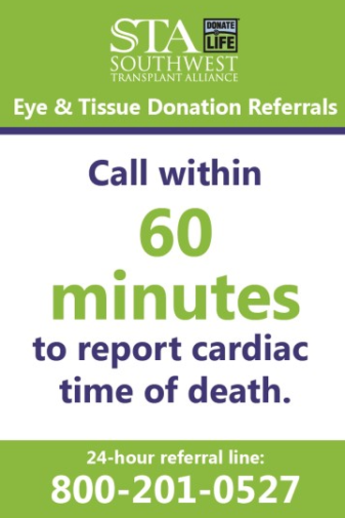
When to call:
EVERY PATIENT DEATH IN THE FACILITY REQUIRES A REFERRAL

Slide 6
Sta process
You will receive a reference number when you initially call, this number should be saved and written down for future use.

Slide 7
TYPES OF ORGAN DONATION:

Slide 8
Process of donation
What can be donated?
Heart
Lungs
Liver
Kidneys
Pancreas/islet cells
Small bowel

Slide 9
Tissue/eye donation

Slide 10
REGISTER TO BE A DONor TODAY!
www.donatelifetexas.org
OR
Department of Public Safety

