Slide 1
Organ / Tissue / Eye Donation Overview Essential Information for Health Care Professionals

Slide 2
Three Donor Agencies serve the hospitals in the Midland/Odessa area Each Agency has a Contract with each Hospital

Slide 3
Southwest Transplant Alliance
(Organ Procurement Organization) (OPO)
RTI Donor Services
(Tissue Procurement Organization)
Western Texas Lions Eye Bank Alliance
(Eye and Cornea Procurement Organization)
All agencies are notified through one phone number
800-201-0527

Slide 4
Major Legislation
1998 CMS Conditions of Participation
Hospitals must have a contract with the Donor Agencies
All cardiac deaths (and imminent deaths) must be called into the designated 800 number
Donor Agency personnel are the only ones who can determine medical suitability
If the patient is medically suitable, the family must be given the option of donation
Only Donor Agency staff, or those trained and certified by Donor Agencies, are to approach families.

Slide 5
Major Legislation
2009 UAGA (Uniform Anatomical Gift Act) (state law), codified into law many of the CMS regulations.
Noteworthy changes:
Hospitals must continue to medically maintain patient while being evaluated for donation
Hospitals must have a Donation after Circulatory Death (DCD) policy
Redefined the legal-next-of-kin hierarchy

Slide 6
As of March 2016…
More than 120,000
people in the United States
were waiting for a
Life-Saving organ transplant…

Slide 7
The power of one…
One Organ Donor…
can save the lives of 8 people,
&
One Tissue/Cornea Donor…
can enhance the lives of
dozens of people

Slide 8
The Donor Process
ORGAN DONORS
1. Referral – Potential Brain Death
6. Surgical Recovery
2. Donor Evaluation
5. Donor Management
3. Brain Death
4. Family Approach/Consent

Slide 9
The Donor Process
TISSUE / EYE DONORS
1. Referral – Cardiac Death
2. Donor Evaluation
by Phone
4. Donor Recovery
Tissue/Corneas
3. Family Approach/Consent by Phone

Slide 10
What is Brain Death?
Brain Death
is the irreversible cessation of all spontaneous brain function, including the brain stem.
Brain death is not a coma or a persistent vegetative state.
The declaration of brain death is the legal time of death that
will be recorded on the patient’s death certificate.
Brain Death may be determined by clinical exams and
confirmatory tests such as an apnea test or a cerebral flow study.

Slide 11
Two Types of Organ Donation
Brain Death
Irreversible, non-survivable brain injury. Patient currently maintained on a ventilator. Tests performed to confirm brain death (e.g. clinical exam, apnea test). Next of Kin provides consent for donation. Pt maintained in ICU while donation evaluation/work up completed. To OR for organ recovery Organ donors may also donate tissues and corneas.
Donation after Circulatory Death (DCD)
Irreversible, non-survivable brain injury. Patient currently maintained on a ventilator. Patient has not progressed to brain death. Family decides to take patient off ventilator. Family wants organ donation to occur, consent given. Pt maintained in ICU while donation evaluation/work up completed. To OR for possible organ recovery Pt extubated, cardiac standstill w/in 60 minutes, rapid organ recovery in OR. DCD donors may also donate tissues and corneas.

Slide 12
Two Types of Organ Donation
Brain Death
Irreversible, non-survivable brain injury. Patient currently maintained on a ventilator. Tests performed to confirm brain death (e.g. clinical exam, apnea test). Next of Kin provides consent for donation. Pt maintained in ICU while donation evaluation/work up completed. To OR for organ recovery Organ donors may also donate tissues and corneas.
Donation after Circulatory Death (DCD)
Pt maintained in ICU while donation evaluation/work up completed. To OR for possible organ recovery. Pt extubated, cardiac standstill w/in 60 minutes, rapid organ recovery in OR. WHAT IF PATIENT DOES NOT CARDIAC ARREST WITHIN 60 MINUTES? Patient is returned to designated room. Patient is not re-intubated. Family resumes financial responsibility for this patient’s care.

Slide 13
When Do I Call?
When a vented patient has severe, acute brain injury (trauma, CVA, etc)
When a patient is ventilated and is missing two or more reflexes
Before any end-of-life discussion with family
When a family member asks about donation

Slide 14
What happens after you call?
For a potential Organ Donor (ventilated, losing reflexes)
A representative from Southwest Transplant Alliance will come on site (day or night) to assess the patient’s medical suitability for organ donation.
If the patient is medically suitable, and if the patient progresses to Brain Death, then the organ donation conversation will occur.
For a potential Tissue/Cornea Donor (cardiac death)
A representative from RTI Donor Services will evaluate the patient by phone. If the patient is found to be medically suitable, the family will be contacted by phone.

Slide 15
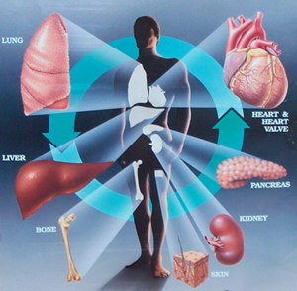
What can be donated?
Organs:
Heart
Lungs
Liver
Kidneys
Pancreas/islet cells
Small bowel

Slide 16
What else can be donated?
Tissue:
Bone
Skin
Corneas
Sclera
Heart Valves
Veins
Cartilage
Tendons
Fascia

Slide 17
General Information
Organ/Tissue/Eye Donation takes place in the operating room of your hospital.
Organ donors remain in the Critical Care Unit until being moved to the OR for recovery.
Organs are recovered by transplant surgeons who travel here from transplant centers. No organ transplants are done in the Permian Basin.
Donor families and organ recipients can meet in the future if both parties agree to sign a release for exchange of information.
Donor agencies cover all costs related to the donation process. There is no cost to the family for any donation.
The donation process will not interfere with the family’s option to have an open casket, visitation or funeral service.
For hospital personnel, please do not call the funeral home until we have had an opportunity to evaluate the patient for donation.

Slide 18
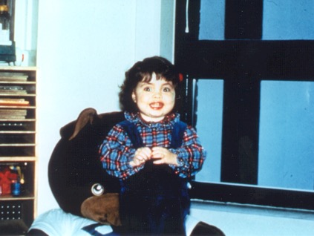
Meet Lily
14 months old Two years old
Lily suffered from biliary atresia and received a liver transplant in 1984 at the age of 15 months ...
This donation happened because someone called the 800#......

Slide 19
This is Lily now!
This is a picture on her wedding day, August 8, 2008.
She picked this day because it was the 24th anniversary of her liver transplant.

Slide 20
Donation Quiz & Answers
1. How many lives can one patient save through Organ Donation? Or enhance by Tissue/Eye Donation?
One Organ Donor can save eight (8) lives (lungs, kidneys, liver, heart, pancreas, small bowel)
One Tissue/Eye Donor can enhance the lives of dozens of patients who are in need of transplants
A patient does not need to be on a mechanical ventilator in order to be a candidate for organ donation.
False... Potential Organ Donors (Brain Dead and/or DCD) must be ventilated
When should a vented patient be called into the 800 number?
As soon as clinical triggers indicate that the patient is losing reflexes
4. Can a patient qualify for organ donation as a brain dead donor & as a Donation After Circulatory Death (DCD)
YES
5. The 1998 CMS Conditions of Participation requires hospitals to do which of the following?
* Hospitals must have a contract with donor agencies / all deaths and imminent deaths must be reported
* Donor agency personnel are the only ones who can determine medical suitability
* If the patient is medically suitable, the family must be offered the option of donation
* Only donor agency staff, or those trained and certified by the donor agencies, are to approach families about donation
* ALL OF THE ABOVE

Slide 21
Donation Quiz & Answers
CONTINUED………..
6. Brain Death may be determined by a clinical exam, with apnea test and/or a cerebral flow study.
TRUE
7. What are the brain stem reflexes that are evaluated for potential organ donors?
Pupils, Corneals, Gag, Cough, Response to Painful Stimuli and Respiratory Rate
8. After a cardiac death, families of potential Tissue/Eye donors may be approached by phone.
TRUE
9. Where can a person register to be an Organ/Tissue/Eye donor? In English or in Spanish?
Online at www.donatelifetexas.org (www.donevidatexas.org) or at the Department of Public Safety (DPS)
10. If a patient is registered to be a donor, does the family still have to make a decision about donation?
NO… the patient made the decision… that’s First Person Authorization
11. What can you say if a family brings up donation?
“My commitment is to care for your loved one. I will contact someone who will talk with you about donation.”

Slide 22
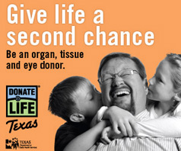
Donate Life Texas
www.donatelifetexas.org - English
www.donevidatexas.org - Spanish

