Slide 1
Interpreter Services

Slide 2
Federal Law
MCH falls under a Federal law and DNV GL requires us to provide services without discrimination based on race, color, or national origin.
MCH is required to:
Provide language assistance to people with LEP (limited English proficiency)
Signs indicating LEP have the right to an interpreter
Friends and family should not be used as interpreters
(except on request by the patient or an emergency)
All of this is No Cost to the patient

Slide 3
Interpretation Levels
Level 1- Basic
Short & Uncomplicated Situations
Level 2- Intermediate
More Complex Healthcare Situations
Level 3- Advanced
Time-sensitive and designated for situations that are complicated/sensitive in nature
Routine Visits
Registration/Admitting
Triage
Appointment scheduling
Pharmacy Refill
Deaf patient
Procedures
Routine Surgery
Informed Consents
Medication Instructions
Social Work/Rehab Assessments
Deaf patient (ONLY request in-person if you are unable to translate through video)
Mental Health
Belligerent/Confused
Conscious Sedation Procedures
Sexual Assault/Child Abuse
Trauma
End of Life Instructions
Life Threatening Cases

Slide 4
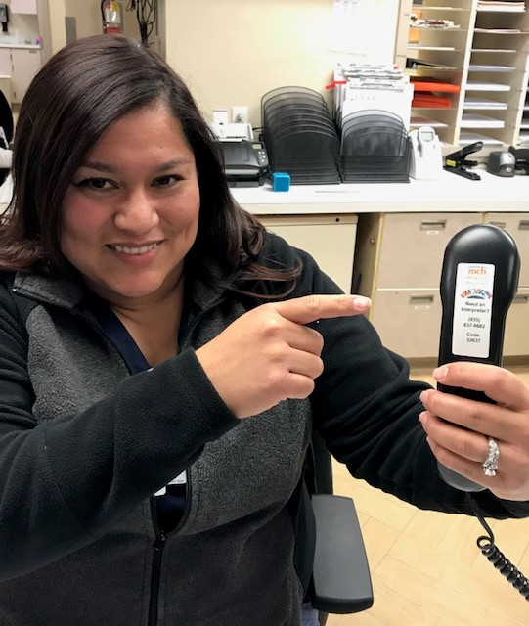
How do we provide interpreters?
By phone:
432-400-4820
By Vocera:
Say “TRANSLATE”
or “MARTTI”
MARTTI
Our Interpreters
Telephone Service
Video
Passed competency exam
Telephone or Vocera

