Slide 1
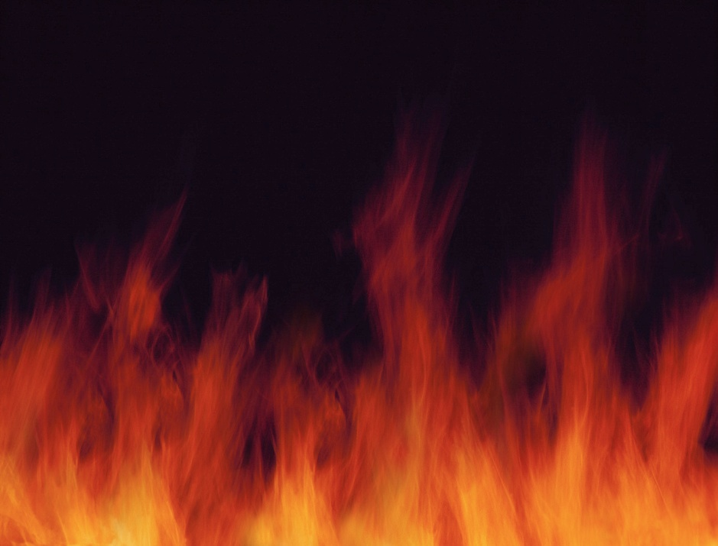
Fire Safety

Slide 2
Chemistry of Fire
Fire burns because there are three elements present
Fuel
Heat
Oxygen
By removing any one element a fire can not occur, or a fire will not be able to sustain combustion

Slide 3
Fire Prevention Practices
Keep passage ways and exits clear
Ensure fire extinguishers and fire alarm pull stations are accessible at all times
Place trash in proper receptacles
Ensure that fire doors are not blocked open

Slide 4
Plan for Fire Emergencies
Read & understand the fire evacuation plan for your area
Know the location of at least two emergency exits
Know the location of fire alarm pull stations and fire extinguishers
Take part in fire drills

Slide 5
In Case of a Fire
Remain calm…..NEVER shout FIRE
Proceed safely to nearest fire exit
Feel surfaces of doors before opening
Crawl to exit if smoke is present in area
Follow instructions of Fire Department
Remember R.A.C.E. and P.A.S.S.

Slide 6
R.A.C.E. for Fire Safety
R escue those in immediate danger
A ctivate alarm (Dial 2000) pull alarm
C ontain the fire (close doors)
E xtinguish the fire

Slide 7
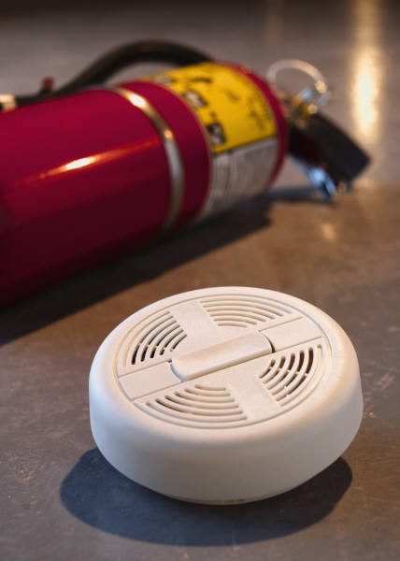
P.A.S.S. for Fire Extinguisher Use
Pull the pin
Aim at base of the fire
Squeeze the handles together
Sweep from side to side

Slide 8
Classes of Fire
Class A- Ordinary combustibles such as wood, paper, and trash
Class B- Flammable liquids such as gasoline, oil, and alcohol
Class C- Electrical equipment such as wiring and appliances
The hospital uses an ABC class extinguisher in the healthcare environment.

Slide 9
Tobacco Free Campus
Medical Center Hospital prohibits smoking or tobacco product use while on any MCH Campus.
Campus means all properties leased or owned in any location by MCH. This includes the interior of all buildings, parking lots, parked cars, garages and sidewalks.

