Slide 1
Falls
Yearly competency

Slide 2
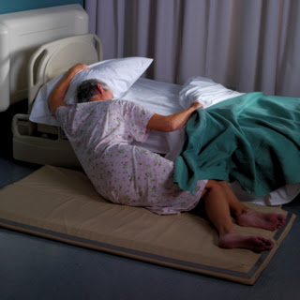
Falls
Falls result in a significant number of injuries among hospitalized patients, long-term care residents, and the home care population.
Thirty to fifty percent of the falls in the acute care setting result in injury

Slide 3
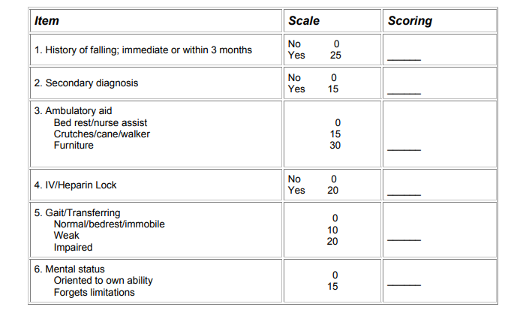
Morse Fall Scale
The Morse Fall Scale (MFS) is a rapid and simple method of assessing a patient’s likelihood of falling.
It consists of six variables that are quick and easy to score, and it has been shown to have predictive validity and interpreter reliability. The MFS is used widely in acute care settings, both in the hospital and long term care inpatient settings.

Slide 4
Morse Breakdown
History of falling
Secondary Diagnosis
This is scored as 25 if the patient has fallen during the present hospital admission or if there was an immediate history of physiological falls, such as from seizures or an impaired gait prior to admission. If the patient has not fallen, this is scored 0. Note: If a patient falls for the first time, then his or her score immediately increases by 25.
This is scored as 15 if more than one medical diagnosis is listed on the patient’s chart; if not, score 0.

Slide 5
Morse Breakdown
Ambulatory Aids
Intravenous Therapy
This is scored as 0 if the patient walks without a walking aid (even if assisted by a nurse), uses a wheelchair, or is on a bed rest and does not get out of bed at all.
If the patient uses crutches, a cane, or a walker, this item scores 15
if the patient ambulates clutching onto the furniture for support, score this item 30.
This is scored as 20 if the patient has an intravenous apparatus or a heparin lock inserted; if not, score 0.

Slide 6
Morse Breakdown
Gait
Mental Status
A normal gait is characterized by the patient walking with head erect, arms swinging freely at the side, and striding without hesitant. This gait scores 0.
With a weak gait (score as 10), the patient is stooped but is able to lift the head while walking without losing balance. Steps are short and the patient may shuffle.
With an impaired gait (score 20), the patient may have difficulty rising from the chair. The patient’s head is down, and he or she watches the ground. Because the patient’s balance is poor, the patient grasps onto the furniture, a support person, or a walking aid for support and cannot walk without this assistance.
When using this Scale, mental status is measured by checking the patient’s own self assessment of his or her own ability to ambulate. the patient is rated as “normal” and scored 0.
If the patient’s response is not consistent with the nursing orders or if the patient’s response is unrealistic, then the patient is considered to overestimate his or her own abilities and to be forgetful of limitations and scored as 15.

Slide 7
Morse Fall Scale Scores
Morse Fall Score
High Risk | Red Sign | 45 and higher
Moderate Risk | Yellow Sign | 25 – 44
Low Risk | No Sign | 0 – 24

Slide 8
Recommended interventions based on fall scores
Precautions | Low Risk | Moderate Risk | High Risk
Bed in Low position | X | X | X
Night Light in Use | X | X | X
Bed/Chair brakes locked | X | X | X
Call light within reach | X | X | X
Hourly Rounding | X | X | X
Non-slip footwear (Yellow Socks) | X | X | X
Medication side effects awareness |  | X | X
Patient/family education about fall risk |  | X | X
Side rails up (X2) |  | X | X
Fall risk band on patient |  | X | X
Fall Risk Signage in place (Yellow for Mod Risk, Red For High Risk) |  | X | X
Yellow Gown |  |  | X
Bed Zone 2 |  |  | X
Remind that staff assist with mobility |  |  | X
Bed exit alarm on |  |  | X
Bedside commode |  |  | X
Review/initiate fall risk care plan |  |  | X
Monitor orthostatic BP |  |  | X
Relocate Patient bed (If Appropriate) |  |  | X

Slide 9
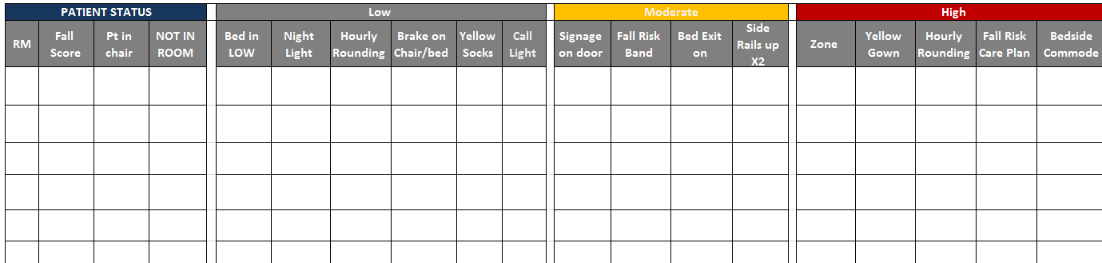
Fall Prevention Audits
Unit directors and charge nurse will be preforming chart/intervention audits on high risk patients to ensure the proper interventions are in place to prevent patient falls.

Slide 10
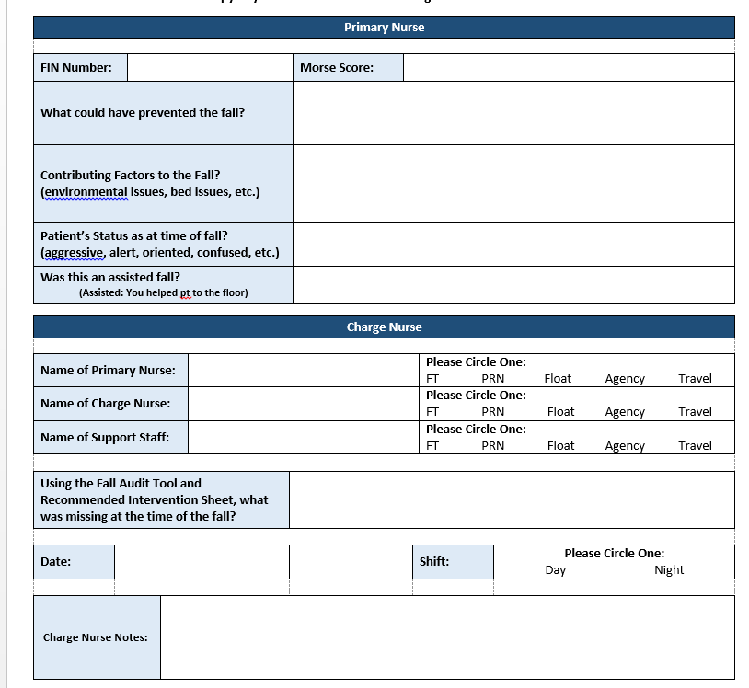
Post Fall Huddle Form
In the event of a fall we are now asking Unit staff to hold a brief post fall huddle.
The primary nurse or charge nurse will fill out the form and turn in a copy to the director and place the original in the yellow fall binder located on each unit (this does NOT replace an ORTS report).
Please make sure to fill out the form in its entirety.

Slide 11
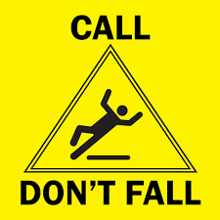
STEADY
S: SIGNAGE on door and only STAFF can transfer the patient in or out of bed and STAY with patient in or outside the bathroom at all times.
T: TOILETING will be assessed during hourly rounding and Gait Belt will be used to TRANFER patient
E: EDUCATE everyone including Family members of S and the use of Call light
A: ACTIVATE bed exit alarm and zone per patient need.
D: DISCUSS fall risk score at bedside shift report and the need for a bedside commode
Y: Yellow Socks and Fall Risk Band

Slide 12
Prevent the Next Fall
Interventions
Tips
Risk Levels
Universal/Low Risk: For all patients with Morse Score of 0 to 24. Implement the Universal Fall Precaution Interventions
Moderate Risk: For all patients with Morse Score of 25 to 44. Implement the Moderate fall risk Interventions
High Risk: For all patients with Morse Score of 45 and higher. Implement High Risk Fall Intervention “STEADY”
Evaluate room placement closer to the nurses station
Ask the family to stay and notify you when leaving
Communicate Fall Risk and Interventions with Team Members
Educate… Educate… Educate…
Don’t forget the Basics:
Keep bed in its lowest position
Keep call light and belongings within reach
Keep the Bedside commode reachable
Keep a clear path to the bathroom
Review fall risk care plan
Document the activation of STEADY in Cerner. That is your proof of safety measures implemented for fall prevention. If it is not documented it is not done.
The Fall Bundle is ALL or Nothing- you cannot pick and choose components to implement. Initiate the bundle and follow through with it.
If the patient has a high fall score and/or they have fallen previously during the hospital stay, staff should consider obtaining approval from the respective ACNO for use of a sitter. (Sitter need should be determined every shift for appropriateness)
The patient’s fall risk should be assessed upon admission, each shift, after change in unit or after any change in health status.

Slide 13
http://www.networkofcare.org/library/Morse%20Fall%20Scale.pdf

