Slide 1
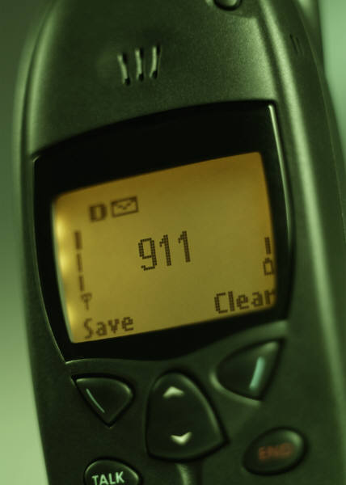
Medical Center Hospital
Plain Language

Slide 2
Plain Language
Medical Center Hospital has a system for responding to the following events:
  Evacuation
  Fire
  Hazardous Spill
  Emergency Plan Activation
  Team Assist
  Severe Weather
  Missing Infant/Child/Person
  Active Shooter
  Bomb Threat
  Combative Person
  Medical Emergency
  Medical Decontamination
  Rapid Response

Slide 3
FACILITY ALERT
Evacuation
  Each department has a specific evacuation plan for their area. Each employee should review the department specific evacuation plan and become familiar with exit routes and fire exits. To prevent blockage of corridors during evacuation procedures, patients should be evacuated in the following order:
  Patients in immediate danger
  Ambulatory patients under supervision
  Bed patients or wheelchair patients who cannot ambulate
  Patients on life-support equipment
Who is authorized to give an order to evacuate an area or the hospital?
  Administration
  Fire Chief
  Law Enforcement
  Safety Officer

Slide 4

Facility Alert
Fire Alarm Activation
  Know the floor plan of your dept. & the hospital as a whole
  Pay attention to exit routes
  Know the exact location of fire alarms and fire extinguishers
  Dial 2000/pull alarm (Rescue, Alert,
    Confine, Extinguish)

Slide 5
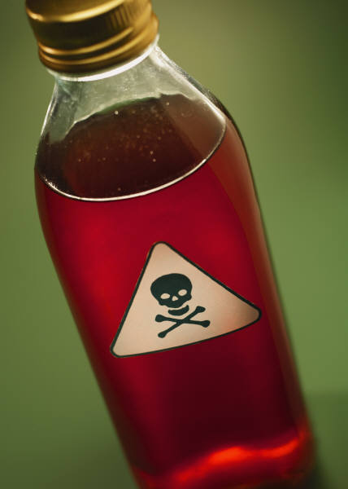
Facility Alert
Hazardous Spill
  Any spill which could present a hazard to people, the environment, or effects unknown.
  Contact PBX
  Isolate spill area
  Deny any entry to area

Slide 6

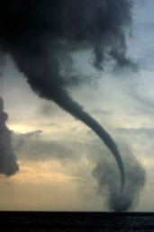
Facility Alert
Emergency Plan Activation
A disaster is any incident or event that disrupts the normal operation of Medical Center. To assist in a quick and efficient transition from normal to disaster operation, the hospital has developed a disaster plan which outlines general guidelines and department functions during emergency operations. The administrator (or designated representative) makes the decision to implement the disaster plan and is responsible for managing disaster operations.
  In the event that a disaster happens within Medical Center Health system or in the community the announcement “Emergency Plan Activation” along with the type of disaster will be called overhead. All staff will return to their departments and await instructions from the supervisors. Disasters may include but not limited to: fire, bomb threat, loss of a major utility system, plane crashes, natural disasters (flood, earthquake, tornado, etc.), civil disturbances, and bioterrorism.
  Emergency Operations Plan can be found on the intranet home page as well as the policy manager. It is included as a part of the Environment of Care Plan. All employees are required to become familiar with the contents of the plan and understand their role in a disaster situation, and should be able to locate this document for reference.

Slide 7
Facility Alert
Team Assist
What is it? Team assist is a team of nurses who respond to units that are experiencing acute workload issues, such as multiple admissions or discharges all at once.
How does it work? The charge nurse will notify the house supervisor when a team assist is needed. The house supervisor will then notify the team and direct them to the unit in need. The charge nurse should be ready to “direct traffic” as each team member will report directly to the charge nurse to identify immediate needs.

Slide 8
MCH Team Assist
Why are we doing this? We are doing this because patient care and safety is a priority. We know that sometimes staff can be overwhelmed with multiple admissions and/or discharges and assistance is needed immediately.
What if this happens after business hours? After normal business hours, the house supervisor will call each unit’s charge nurses and ask if there are staff members available to help. Any available staff will report to the affected unit’s charge nurse, help out and perform their tasks, and be dismissed back to their unit of origin as soon as possible.
**Note: Team is intended to be a short-term and quick solution to an immediate need. The team should be dismissed as soon as possible.

Slide 9
MCH Team Assist
VERY IMPORTANT: Team assist is a solution for workload issues, not for patients with changes in acuity or a change in clinical factors affecting workload. RAPID RESPONSE TEAM remains the appropriate method for resolving these types of problems.
Team Assist Members:
*Educators
*Directors

Slide 10
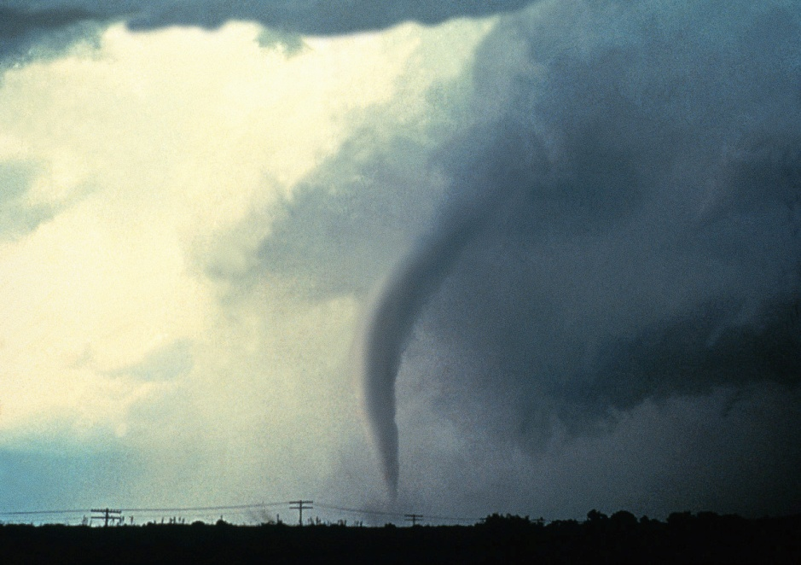
Weather Alert
Severe Weather
  Close all doors, curtains, & blinds
  Don’t tie up the telephone lines
  Unplug nonessential electrical equipment
  Remain in assigned dept.
  Prepare for evacuation
  Move to central hallway

Slide 11
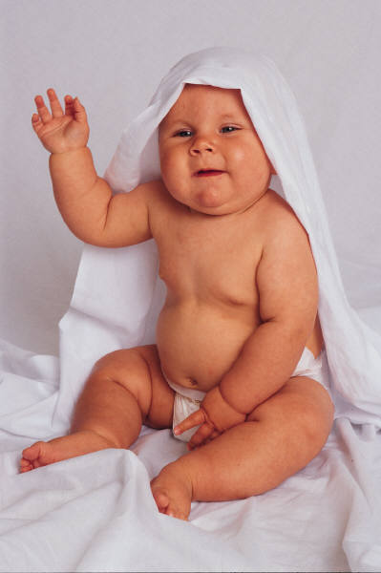
Security Alert
Missing Infant/Child/Person
  Go to closest exit and watch for anyone with an infant or with a bag that could hold an infant.
  Get a good description of the person
  Report information to security

Slide 12

Security Alert
Active Shooter
  Active Shooter
  Avoid-Exit the area quickly if it’s safe to do so and notify 2000/911
  Deny-Be prepared to take cover and deny entry, Notify 2000/911
  Defend-As a last resort use anything necessary as a weapon to survive and protect.
  ECHD police will respond. Wait for their instructions.

Slide 13

Security Alert
Bomb Threat
  This is the notification of a bomb threat (usually made by a caller)
  Try to keep the caller on the phone. Obtain as much info. as possible.
  Report information to supervisor
  Report anything suspicious

Slide 14

Security Alert
Combative Person
  Called when someone is about to cause harm to themselves, the staff or the hospital property
  Dial 2000
  The team & security will respond to the location
  The team will assume control of the situation and direct team members as needed

Slide 15
Medical Alert
Medical Emergency - Code BLUE
  Cardiac and/or Respiratory Arrest
  Dial 2000 and give patient’s name and room
    number, location, and doctor’s name
  The code will be announced overhead
  The code team will respond

Slide 16
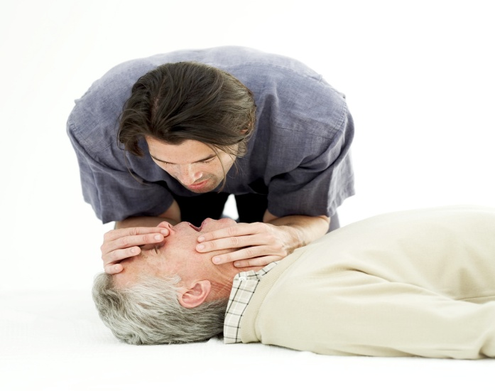
Medical Alert
Rapid Response
  Person is in distress. Precursor to Code Blue if the situation escalates
  Dial 2000
  The Rapid Response Team will arrive to assess and stabilize the situation
  Families and visitors CAN call a rapid response. They dial 777 from the patient room if they or their family member needs assistance.

Slide 17
Medical Alert
Medical Decontamination
  In the event that an individual having a contaminant on their person comes to the hospital or is contaminated on the hospital grounds, the patient should be taken to the emergency department decontamination room.
  Contact PBX to alert the MCHS medical decontamination team, they will respond by washing the patient prior to the patient entering the facility. This will protect our staff as well as our facility.
  When contacting PBX, please give as much information as possible, to include the possible contaminate on the patient.

