Slide 1
Accreditation & Licensure
What types & Compliance

Slide 2
Surveys
Accreditation
  Currently MCH uses DNV as our accrediting organization
  They do onsite/virtual surveys every year (last survey Nov 2020)
    New survey expected between July and September 2021
    Initial DNV Stroke Certification survey expected in March 2021
Other
  Surveys for disease specific programs & our trauma services
  Also the state can come in for complaint surveys at anytime

Slide 3
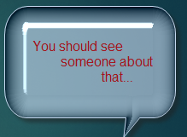
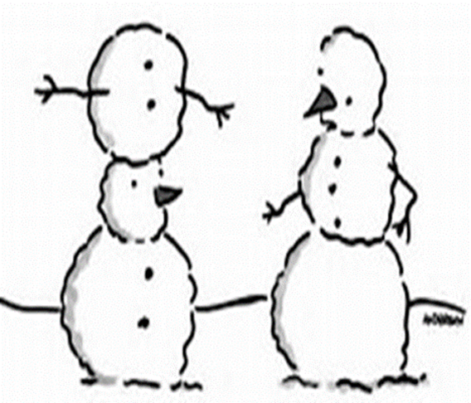
What can you do?
Look around your area –
It’s the small things that in our environment that go unnoticed
However, these are the things that are noticed by patients and families
Think of yourself in a restaurant, waiting & looking around…
    Yeah, it’s those things…
IF it doesn’t look right – let someone know

Slide 4
All these things were cited by DNV in November and/or during other previous surveys
Tape residue on carts
PPE in designated “clean” areas (ie food/drink areas)
Exit paths not clearly marked
Compressed gas cylinders not individually secured
Emergency pull cords in bathrooms – found looped around the assist bars
Nutrition rooms should be clean and tidy & labels on patient food
Expired Broselow Tape on carts

Slide 5




Report a Patient Safety Event
Do you have a patient safety event or concern about a health care organization?
How do you file a concern?
https://www.dnvglhealthcare.com/patient-complaint-report
Fax: 513-947-1250
Phone: 866-496-9647

Slide 6

.
Crystal Sanchez, MLS(ASCP)^{CM}
Accreditation & Licensure Specialist
⁽⁴³²⁾ ⁶⁴⁰⁻¹¹⁷⁴
^{csanchez1@echd.org}

