Slide 1
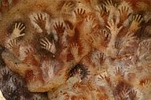
Transcultural Guidelines for Health Care Providers

Slide 2
Ethnicity
Definition: Describes your family “origins”
American Native or Alaskan Native
  Origins in any of the original peoples of N & S America who maintain tribal affiliation or community attachment
Asian
  Far Eastern countries
Black/African American
  African or Caribbean
Caucasian/White/Not of Hispanic Origin
  Europe, Middle East, North Africa, Australia, New Zealand
Mexican American
  Of Mexican culture or origin regardless of race
Native Hawaiian or other Pacific Islander
  Hawaii, Guam, Samoa, Pacific Islands
Puerto Rican
  Puerto Rican culture or origin
Other Hispanic
  Cuban, South or Central America, Dominican Republic, or other Spanish culture or origin, regardless of race

Slide 3
Cultural Competency
Understanding of own self
Knowledge of various cultural characteristics
Application of cultural knowledge & understanding in the health care setting

Slide 4
Ethnocentrism
Even though we understand that everyone is different, we still tend to subconsciously believe that our culture & religion is the right one. We may view other cultures or religions as bizarre, strange, inferior or unenlightened. This is called ethnocentrism
It can cause misunderstandings and harm patients by:
  Incorrect Dx
  Failure to provide adequate pain relief
  Arrest of parent for child abuse due to misunderstood cultural childrearing beliefs and practices

Slide 5
Avoid Stereotyping
We must not presume that all people of a certain cultures adhere to all aspects of their culture
The healthcare provider must identify which aspects are appropriate for each patient during the admission process

Slide 6
Do No Assume Anything
Be truly open minded & respectful toward other’s beliefs, values, & practices
You can help patients feel more comfortable
Many of us belong to more than one ethnic group, cultural group, age group, and social group

Slide 7
Language & Translation
Those whose English is limited often wish to speak their native language when possible
They feel that both their explanations & their understandings can be more accurate
It is most comfortable

Slide 8
Translation
Family members are not good translators
Issues of privacy & confidentiality
Interpreter errors could be a previously unrecognized root cause of medical errors

Slide 9
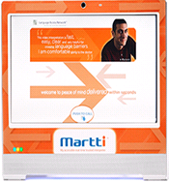
MARTTI (My Accessible
Real Time Trusted Interpreter)
Medical Center Hospital has an Interpreter Services Program.
Call Quality and Service Excellence Division at ext. 1240 for directions on this service

Slide 10

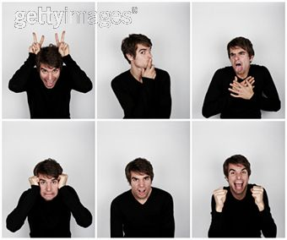
Face and Body Language
Facial expressions, body language & tone of voice play a much greater role in many cultures

Slide 11
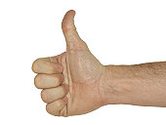

Gestures
Use with care some may have a negative meaning to other cultures
The thumbs up and the OK sign are obscene gestures in some cultures
Finger pointing and snapping is seen as rude

Slide 12

Touch
Cultures also have different rules about who can be touched & where
Even casual touching people of the opposite gender can be offensive in some cultures

