Slide 1
Compliance Program at MCHS

Slide 2

Why does Compliance exist?
To ensure our hospital system follows State and Federal laws that relate to healthcare fraud and abuse.

Slide 3
The OIG’s Seven Elements of a Compliance Plan
Chief Compliance & Privacy Officer
Compliance Committee
MCHS Compliance Standards of Conduct
(You have the book in your packet. In the back you are attesting to this training and to the monitoring of your access of PHI)

Slide 4


Seven Elements (continued)
Education
Training &
Policies & Procedures

Slide 5
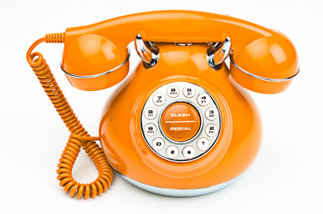
Seven Elements (continued)
Hotline
Maintain Log of Calls
*Hotline – 1-800-805-1642
*Compliance Hotline– On MCH Intranet under Featured Links
*Walk-In – The Compliance
Office hours M-F, 8a.m.-5p.m.
*In-House Hotline – 640-1900
*Integrity Boxes – located on each unit and MCH Urgent Care Clinics & MCH ProCare Clinics
*Compliance Committee
Members

Slide 6
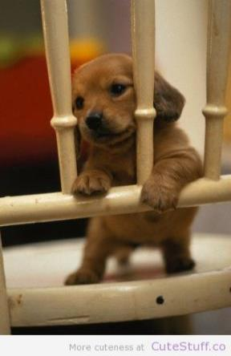
Enforcement
Fraud and Abuse can lead to Jail time.
We have corrective actions at MCHS for violations.
Report wrong doing so you don’t become culpable.
I, I promise I didn’t do it.

Slide 7
It takes us ALL!!
You are the eyes and ears of MCHS. You make a difference when you report wrong doing.

