Slide 1
Clinical Ethics

Slide 2
What is Clinical Ethics?
Using moral principles to guide choices in patient care with a team of community members, ministers, support services personnel, legal counsel, and healthcare providers meeting with the family members.

Slide 3

What is the Purpose for Clinical Ethics?
To strive to facilitate communication between families, providers and community members and resolve differences of opinion.
  The committee
  does not make a decision, it is still the
  families decision for the next
  level of care.

Slide 4
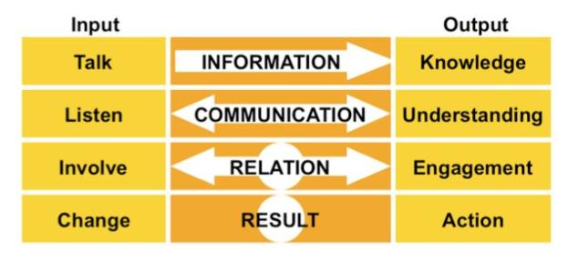
We want to get to know the patient and find out what the patient would want in this situation. Many times consults can be at the bedside in a small informal meeting.

Slide 5

Cultural and Religious Diversity
We try to be
considerate
of the patient’s
cultural and
religious
background
and to listen
to the family’s
concerns.

Slide 6
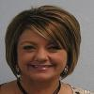
MCHS Clinical Ethics Committee
Kimberly Leftwich, Assistant Chief Nursing Officer
MCHS Clinical Ethics Committee Chair
kleftwich@echd.org
The mission of the Ethics Committee has three main parts: education; help for decision makers; and support for care providers.
Anyone who believes an ethical dilemma exists pertaining to a patient at Medical Center, can request the involvement of the Ethics Committee.
To contact the Ethics Committee call: (432) 640-2182

Slide 7

Education Outreach
We promote awareness in the community by teaching about Advanced Directives and Living wills.

