Slide 1
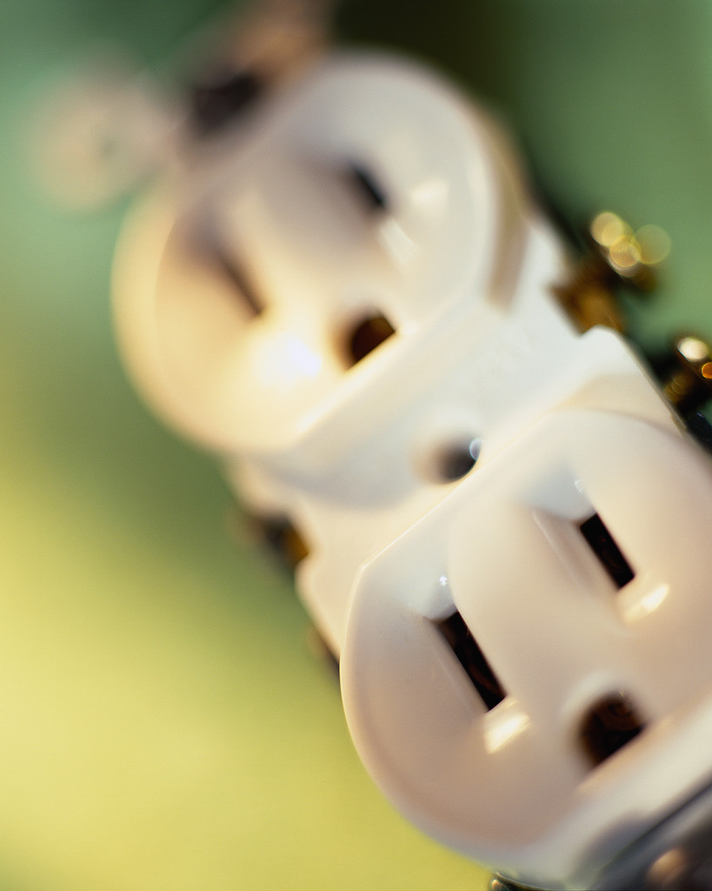
Electrical Safety

Slide 2
What is Electricity?
A medium that provides a means for transferring energy from one place to another
It is not expensive or difficult to control the risk of an electrical hazard, but ignoring them can cause serious consequences

Slide 3
Characteristics of Electricity…
Electricity has most of the characteristics of water, in that it flows and has a current that can be measured
Electricity is measured in volts, amps and watts.
Volts measure the “pressure” under which electricity
flows.
Amps measure the amount of electric current.
Watts measure the amount of work done by a
certain amount of current under a certain pressure

Slide 4
Electrical Faults can Result in Shock, Burns, or Fire……
Flow of Current
Occurs when a person or conducting
object bridges the gap between live
conductors and the ground or between two
live conductors.
This action causes currents to flow.

Slide 5
Electrical Faults can Result in Shock, Burns, or Fire……
Static Electricity
Occurs when static electrical charges
accumulate from friction between
dissimilar materials. Discharge of static
electricity causes a mild shock.

Slide 6
Causes of Electric Shock…….
Current flow is the factor that causes injury in electric shock; body resistance will determine the path of flow.
Once the skin is broken, a victim will have sharply reduced internal resistance to the flow of current

Slide 7
Electrocution or Shock
Circuits of 110 volts or less can kill when the conditions are right. This is regular household currents.
Any direct contact with 110 or 230 volt wiring has the potential for electrocution. Low-voltage currents frequently affect the heart, causing ventricular fibrillation.
Electrical shock can cause complications such as vascular injury, LOC, damage to the respiratory center, infection, cardiac arrythmias or eye damage.

Slide 8
Overcurrent Devices….
Protect circuit from excessive heating by opening the circuit automatically in event of excessive current flow from accidental ground, short circuit, or overload.
Examples include fuses and circuit breakers

Slide 9
Ground Fault Circuit Interrupter…..
GFCI is a fast-acting circuit breaker that is sensitive to very low levels of current leakage (5mA) to ground. When leakage becomes hazardous, it interrupts circuit.
You will find GFCIs in what electricians call “wet” areas such as kitchens and bathrooms.
GFCIs are normally used for outside wiring outlets.

Slide 10
Electrical Safety Policy…..
An equipment management plan exists to identify, evaluate, inventory, and maintain medical equipment to reduce the physical and health risks associated with its usage.
All biomedical and electrical equipment used in a hospital must be inspected and tested prior to use and labeled with a safety sticker.
All electrical devices that a patient may bring into the hospital needs to be inspected and tested prior to use and labeled with a safety sticker prior to their use.

Slide 11
Electrical Safety Rules…..
Visually inspect all equipment for damage prior to use
Do not use extension cords for permanent wiring
Unplug equipment by pulling on the plug and not the cord
Damaged or defective biomedical/electrical equipment must be removed from service and reported to appropriate authority for repair

Slide 12
Electrical Safety Rules…..
Keep fluids, chemicals, and heat away from equipment, cords, and cables.
Maintain sufficient access around equipment and panels for operations/maintenance.
Do not touch energized/conductive surfaces with one hand while touching the patient with the other.
Know the function of each control prior to using equipment.

Slide 13
Emergency Power
Hospitals are equipped with emergency generators which will start automatically if there is a loss of electrical power.
Emergency generators are tested monthly.
Red electrical outlets provide emergency power for critical patient care equipment.

