Slide 1
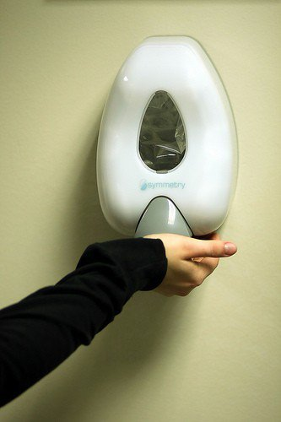
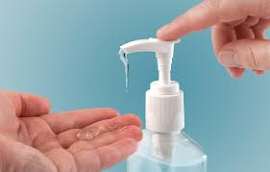

Infection Prevention
Or
How I learned to be more conscientious and love the gel.

Slide 2

What do we do?
Monitor Hand Hygiene compliance
Monitor equipment cleaning
Provide education to staff and visitors: Orientation, in service, newsletter, display case, blog, social media
Provide education to outpatients/community
Provide a resource for staff
Research
ID Surveillance: CLABSI, CAUTI, SSI
Work with engineering on ICRA’s, temperature/humidity monitoring, airflow
Collect and report data to the local health departments, TxDHS and Nat’l Safety Health Network

Slide 3
How Are Infectious Diseases Spread?
Understanding how infectious diseases are spread is important for minimizing the risk of infection and preventing disease transmission.
Three ways in which infectious diseases can be transmitted:
Direct transmission
Indirect transmission
Airborne transmission

Slide 4

What tools does MCHS provide to keep you safe?
Engineering Controls: Sharps Containers, Negative pressure rooms, Air flow
Personal Protective Equipment
Hand wash stations
Proper cleaning products
Educational Opportunities
Influenza and Hep B vaccinations free to all employees.

Slide 5
Personal Protective Equipment or PPE
Consists of gloves, gowns, masks, eye protection, shoe protection
Use is based on type of precaution:
  Standard (Universal) precautions – the belief that every patient, every situation is potentially hazardous.
    Hand Hygeine
    Gloves
  Transmission based precautions – choosing the correct PPE according to the mode in which a disease is spread.
    Hand Hygiene
    Gloves
    Proper PPE for transmission
Isolation precaution signs instruct your behavior for isolation rooms
  Placed on door of isolation patient rooms
  Isolation carts with PPE will be outside room

Slide 6
Examples of contact isolation appropriate patients:
MDRO’s such as MRSA and VRE
Draining wounds
Scabies, Lice, Bed bugs

Slide 7
Examples of Droplet isolation appropriate patients:
Seasonal Flu
Bacterial Meningitis
Strep Throat
Pertussis/RSV

Slide 8
Examples of Airborne/Respiratory precaution appropriate patients:
Tuberculosis (TB)
Shingles/Chicken Pox (dessiminated)
Measles
Avian Flu

Slide 9
Examples of Special Enteric precaution appropriate patients:
Clostridium dificile (C.diff)
Norovirus
Acute Diarrhea

Slide 10
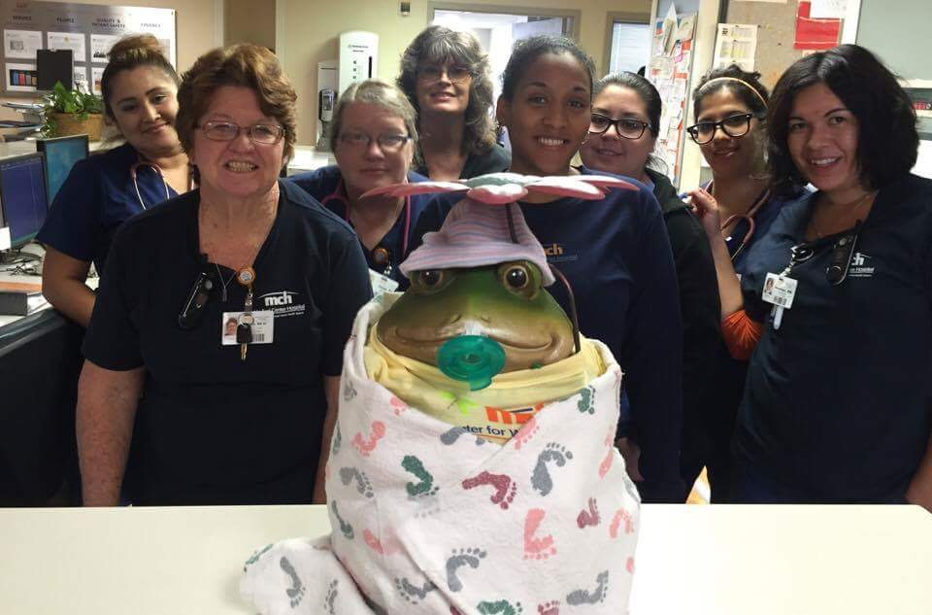
Hand Washing
Components of proper hand washing include:
- Soap
- Clean water
- Hand gel/sanitizer
- Friction (F-R-O-G: Friction rubs out germs)

Slide 11

Hand Hygiene
Your hands are NASTY! Think of everything you touch in a single day!
Some things we can see: Blood, feces, other matter.
Some things we can’t see: bacteria, viruses, spores.
Hand washing is your first line of defense for your safety AND your patient’s.
Remember: If it’s wet, slimy and not yours, don’t touch it.

Slide 12

What things should you do to keep yourself, your patients and your co-workers safe?
Wash…Your…Hands
Clean your equipment
Ask colleagues to wash their hands
Educate patients/patient families about hand washing and isolation precautions
Get vaccinated annually!
Wash…Your…Hands

Slide 13
When to Wash Hands
Before and after glove use
After blowing the nose, sneezing, or coughing
After going to the bathroom
After contact with blood or body fluids, such as saliva, nasal secretions, urine, feces, or vomit
After handling garbage or waste
When hands appear soiled
Before preparing medicines or handling contact lenses
Before preparing, serving, or handling food
Before eating lunch or snacks
Frequently when sick or after contact with others who are sick
Before and after touching a cut or wound
Before and after touching eyes, nose, or mouth
After handling animals, animal waste, or their belongings, such as toys or a leash
After changing a diaper

Slide 14
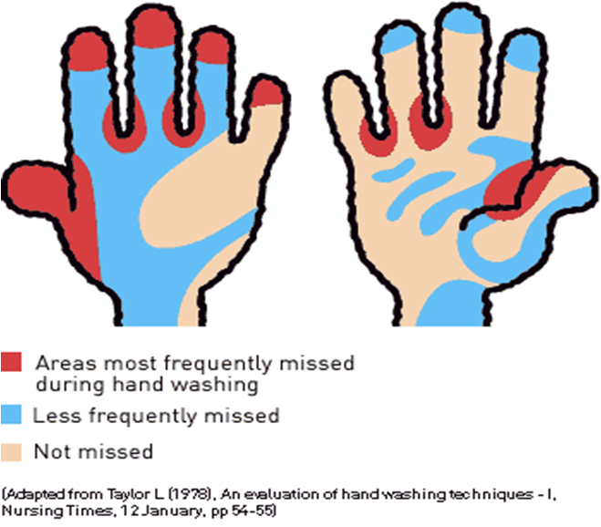
Frequently Missed Areas

Slide 15
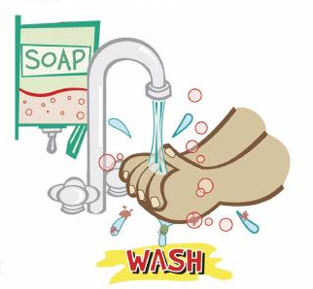
Ways to prevent spreading infection
Encourage personnel to wash hands frequently using soap and water for 15-20 seconds.
Substitute alcohol-based hand sanitizer when clean water and soap are unavailable.
Promote appropriate respiratory etiquette: Cover coughs and sneezes with tissue. Throw away tissues immediately and WASH YOUR HANDS. If a tissue is not available, sneeze or cough into the elbow or upper sleeve.
Remain at home when ill and encourage others to do the same.
Avoid close contact (less than 3 feet of space) with those who are sick
Maintain and promote good personal hygiene; bathe and wash hands regularly
Discourage touching the eyes, nose, and mouth.
Maintain a clean working environment.
Ensure commonly used areas such as door handles, eating surfaces, and desks are clean and disinfected.

Slide 16

Keep open or draining wounds clean and covered with a bandage.
Avoid contact with other people’s wounds or bandages.
Discourage sharing eating utensils, glassware, or personal items such as combs, razors, towels, clothing or other items that come into contact with bare skin.
Clean shared equipment before and after each use.
Avoid skin-to-skin contact with anyone who has an open wound or skin infection.
Encourage a healthy lifestyle that includes a nutritious diet and adequate sleep.

