Slide 1

HAZARDOUS MATERIALS

Slide 2
HAZARDOUS MATERIALS
AND WASTES
Hazardous materials are any materials in use that are considered to represent a threat to human life or health, or to the environment.
Hazardous wastes are materials no longer in use that represents a threat to human life or health, and to the environment.

Slide 3
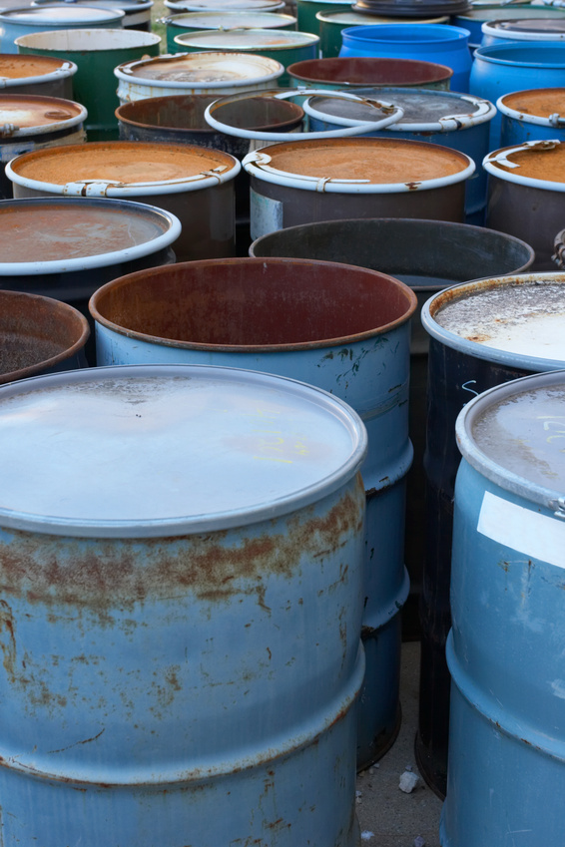
HAZARDOUS WASTES
Knowledge of the proper procedures in the special handling, use, storage, and disposal of hazardous materials and wastes

Slide 4
RIGHT TO KNOW - GHS
Globally Harmonized System of Classification & Labeling of Chemicals
OSHA’s Hazard Communication Standard gives employees working around hazardous chemicals the right to know of possible dangers and how to protect themselves.
OSHA has chosen to incorporate the Globally Harmonized System of Classification and Labeling of Chemicals (GHS) into the HCS to:
Account for changes in workforce
Adapt to globalization
Increase worker safety

Slide 5
HAZARD CLASSIFICATION
Understanding Classification is the starting point for hazard communication. It involves you as an associate identifying the hazard(s) of a chemical or mixture by the assigned category of hazard by reading the labeling or finding it on the SDS sheets.
Hazard Classification includes you performing steps:
Identifying data related to the hazards of a chemical and reviewing it to ascertain hazards
Determining that the chemical is hazardous (based on physical, health or other hazards)
Identifying the hazard class(es) for the chemical
Identifying the hazard category for each hazard class
All can be found on the label or SDSs Sheets

Slide 6
LABELING
Labels are intended to provide an immediate visual reminder of chemical hazards.
All labels will be required to have:
    Product identifier
    Supplier identifier
    Chemical identity
    Hazard pictograms
    Signal words
    Hazard statements
    Precautionary information

Slide 7
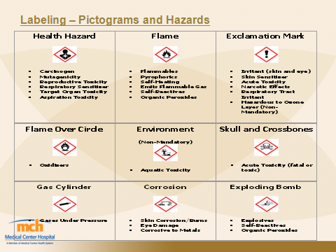
LABELING-PICTOGRAMS AND HAZARDS

Slide 8
TYPES OF HAZARDOUS MATERIALS
Infectious Substances
  Some infectious substances (such as some viruses) can be transmitted by blood and other body fluids, equipment, containers, paper goods, glassware, linens, and by people
Radioactive Materials
  These require special handling techniques to prevent exposure to personnel and visitors

Slide 9
TYPES OF HAZARDOUS MATERIALS
Flammable Liquids and Gases
  For example, chemicals, such as ether or alcohol, can burn or explode
Toxic Chemicals
  A person may be exposed over a long period of time before effects are noticed

Slide 10
ROUTES OF ENTRY
Inhalation- you breath it (most common)
Ingestion- you eat it
Absorption- soaks through skin
Injection- puncture wound

Slide 11
REMEMBER
Many hazardous materials are odorless, colorless, and tasteless
You may be exposed before you know it
Approach safely

Slide 12
SECTIONS FOUND ON SAFETY DATA SHEETS (SDS)
Product and Company Identification
Hazards Identification
Composite/Information on Ingredients
First Aid Measures
Firefighting Measures
Accidental Release
Handling and Storage
Exposure Control/Personal Protective Equipment
Physical and Chemical Properties
Stability and Reactivity

Slide 13
SAFETY DATA SHEETS CONT.
Toxicological Information
Ecological Information
Disposal Considerations
Transport Information
Regulatory Information
Other Information

Slide 14
KNOW THE POTENTIAL HAZARDS
In each area of the facility where you work
Observe signs
Take precautions when entering an area identified as hazardous
Know what’s inside a container before you handle it

Slide 15
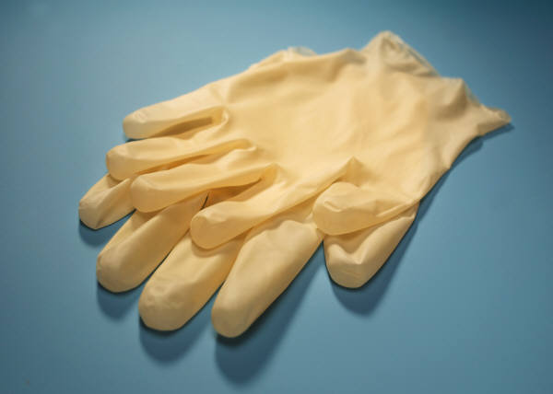
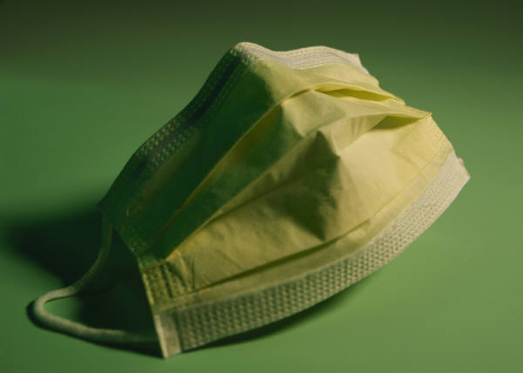
PERSONAL PROTECTIVE EQUIPMENT (PPE)
Gloves
Goggles
Masks
Gowns
Aprons
Footwear
Good Hygiene

Slide 16
IN CASE OF UNKNOWN
MATERIAL SPILL
If capable, attempt to clean the spill yourself
If unable, contact Housekeeping
Protect the area to prevent other incidents from occurring
Please take responsibility in helping keep MCHS clean and safe for all visitors and staff

Slide 17
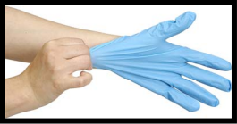
IN CASE OF A CHEMICAL SPILL
Rescue anyone in the area
Alert PBX- Dial Ext 2000
Confine the spill/obtain appropriate PPE/clean area
Extinguish or Evacuate
  MMH Activate Alarms-Dial 1100

Slide 18

BE SURE TO WASH YOUR HANDS
Before entering or leaving the work area
Before and after contact with a patient
After handling items such as bedpans, dressings, etc.
After removing gloves
After using the toilet, blowing your nose or covering a sneeze
Before eating, drinking or handling food or after smoking

Slide 19
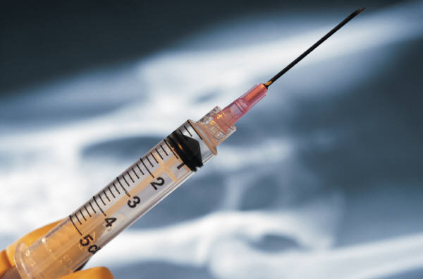
PREVENT INJURIES FROM SHARPS
Let falling objects fall
Practice safe handling techniques
Don’t reach into containers
Dispose of sharps carefully

Slide 20
IMPORTANT TIPS
Take training seriously
Avoid shortcuts
Report unsafe conditions
Know emergency procedures

